Slide 1

Linux Fundamentals by
Ahmad Khaled Hassanien

Slide 2
Day4 Content
Linux Services.
Inode, Soft Link and Hard Link.
File System Management
Cron Jobs
Achieving and Compression

Slide 3
Linux Services

Slide 4
Linux Services
A service is an application (or set of applications) that runs in the background waiting to be used, or carrying out essential tasks. Examples of services are MySql, Nginx and Docker.
System starts processes called daemons which are processes that run in the background and provide services performing a particular task.
We control services using:
systemctl [options] service_name
service service_name [options]

Slide 5
Linux Services
To stop this service, we run: sudo systemctl stop docker
To start it again, we run: sudo systemctl start docker
To check service status:
sudo systemctl status docker
To enable/disable service auto start when system boots:
sudo systemctl enable/disable docker

Slide 6
Inode, Soft Link and Hard Link

Slide 7
Inode, Soft Link and Hard Link
Each file system (partition) has an inode table, in which all of the used inodes are mapped to particular files.
Linux stores administrative data about files in inodes.
Information stored in the inode table are:
Size
Device ID
UID
GID
Mode
Time stamps
Pointer to date

Slide 8
Inode, Soft Link and Hard Link
Inode table does not contain the file name or its content.
Names are stored in the directory.
Each file name knows which inode it has.
An indoe does not know which name it has, It just know how many names are associated with the inode, these names are referred to as hard links.

Slide 9
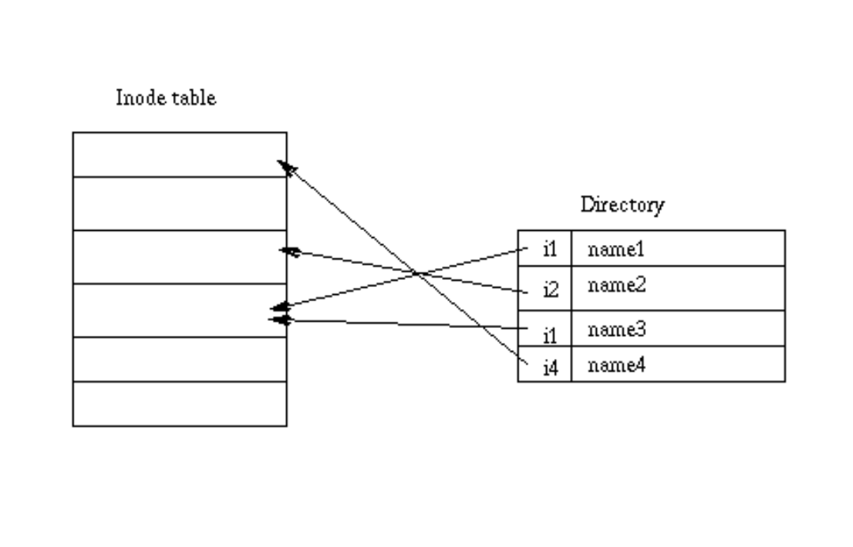
Inode, Soft Link and Hard Link
Metadata include:
Type of file
File permissions
Number of links (Hard)
UID
GID
Time Stamps
Pointer to date
Metadata i4
Metadata i2
Metadata i1

Slide 10
Inode, Soft Link and Hard Link
To get information about inode of your partiton:
df -i file_system Example: df -i /dev/sda5
To get indoe of file:
ls -l file_name
To get indode of a directory:
ls -id directory_name

Slide 11
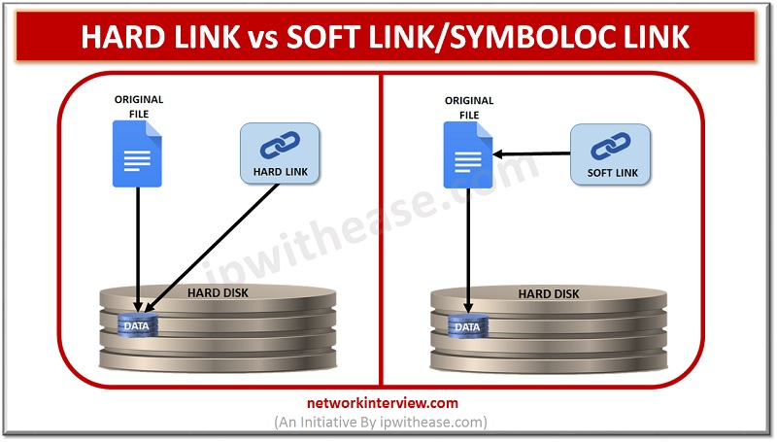
Inode, Soft Link and Hard Link
Hard Links V.s Soft Links:

Slide 12
Inode, Soft Link and Hard Link
Hard Links: Syntax:
ln original_file file_hard_link
When you create a file, you give it a name. Basically, this name is a hard link.
On a Linux file system, multiple hard links can be created to a file. This can be useful, because it enables you to access the file from multiple different locations.

Slide 13
Inode, Soft Link and Hard Link
If the first hard link that ever existed for a file is removed, that does not impact the other hard links that still exist.
Some restrictions apply to hard links, though:
Hard links must exist all on the same device (partition, logical volume, etc).
You cannot create hard links to directories.
When the last name (hard link) to a file is removed, access to the file’s data is also removed.

Slide 14
Inode, Soft Link and Hard Link
Soft Links: Syntax:
ln -s original_file file_soft_link
Soft links are also known as Symbolic Links.
New entry is made to the inode table for the link, the content of this entry is the path to the original file.
This allows you to use symbolic links across partition boundaries.

Slide 15
Inode, Soft Link and Hard Link
The advantage of symbolic links is that they can link to files on other devices, as well as on directories.
Note that when the original file is removed, the symbolic link becomes invalid and does not work any longer.

Slide 16
File System Management

Slide 17
File System Management
We use “fdisk” utility to manage file system, like creating or deleting partitions.
To list your partitions and storage disks, run:
sudo fdisk -l
Or df –h
Run: “sudo fdisk disk_name” to modify its partitions.
Example: sudo fdisk –l /dev/sda

Slide 18
File System Management
Once inside fdisk, you can:
View help -> m
Delete a partition -> d
Lists known partition types -> l
Adds a new partition -> n
Prints the partition table -> p
Quits without saving changes -> q
Writes table to disk and exit -> w

Slide 19
File System Management
After creating the partition run “partprobe”.
Then you need to format the newly created partition:
mkfs–t ext4 /dev/sda3
Create a mount point for the partition:
mkdir /my-partition
Finally, mount the newly created partition:
mount /dev/sda3 /my-partition

Slide 20
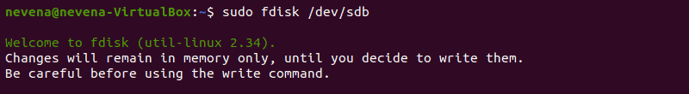
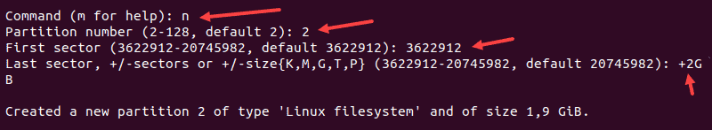
File System Management

Slide 21

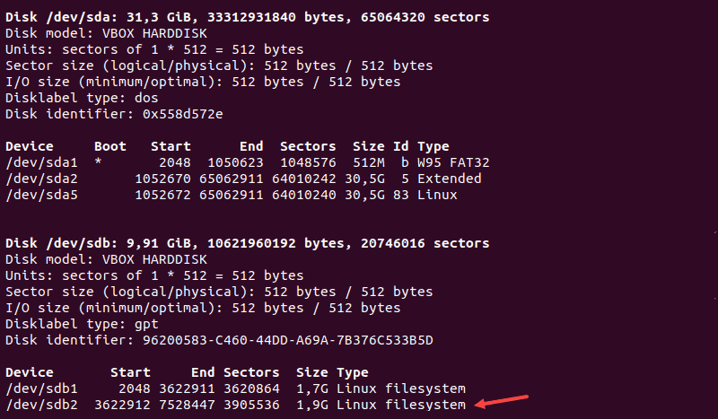
File System Management

Slide 22
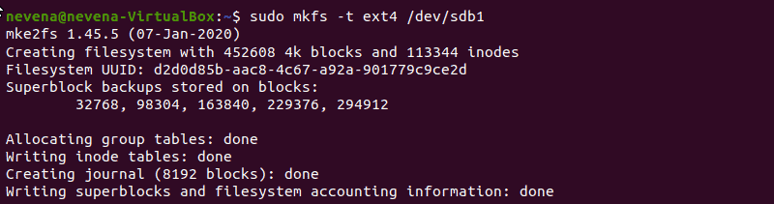
File System Management

Slide 23
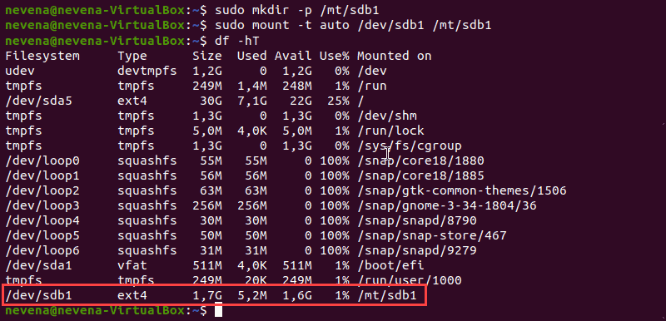
File System Management

Slide 24
Cron Jobs

Slide 25
Cron Jobs
Cron allows Linux and Unix users to run commands or scripts at a given date and time.
Here are the reasons for using cronjobsin Linux:
Helps OS to take a scheduled backup of log files or database.
Delete old log files
Send out any notification email such as Newsletters, Password expiration email
It is used to automate system maintenance

Slide 26
Cron Jobs
Creating a cronjob, use “crontab -e” command.
Syntax:
1 2 3 4 5 /path/to/command arg1 arg2
Where:
1: Minute (0-59)
2: Hours (0-23)
3: Day (0-31)
4: Month (0-12 [12 == December])
5: Day of the week(0-7 [7 or 0 == sunday])
Here are the reasons for using cronjobsin Linux:
Helps OS to take a scheduled backup of log files or database.
Delete old log files
Send out any notification email such as Newsletters, Password expiration email
It is used to automate system maintenance

Slide 27
Achieving and Compression

Slide 28
Achieving and Compression
The “tar” command archives files to and extracts files from a single file called a tar file.
Syntax: tar [options] archive-file filenames
Options:
c: create a new tar file
t: list table of content
x: extracts files from the tar command
f: specify the archive file
v:verbose mode

Slide 29
Achieving and Compression
Before creating a tar archive, verify that there is no other archive in the directory with the same name as the new archive to be created. The tar command will overwrite an existing archive without any feedback.
For tar to be able to archive the selected files, it is mandatory that the user executing the tar command is able to read the files.

Slide 30
Achieving and Compression
Compressing Files:
Files can be compressed using different commands.
z for gzip compression (filename.tar.gz or filename.tgz)
j for bzip2 compression (filename.tar.bz2)
J for xzc ompression (filename.tar.xz)

Slide 31
Thank you Any questions?

